Slide 1
Using PR to Support Your Legislative Agenda
Tips and Tactics for Sharing Your Story

Slide 2
Public relations is a strategic communication process that builds mutually beneficial relationships between organizations and their publics. -PRSA

Slide 3
Why is Public Relations Important?
Public relations helps you tell your story in a way that is consistent, relevant, and effective
Public relations works in conjunction with fundraising, government affairs, DEI initiatives, lobbying, and more
Public relations is about sending the right messages to the right people at the right time
By sharing your story, you can get people emotionally-invested in your mission, influence public opinion, and enact lasting change

Slide 4
Communications Tactics
There are a wide variety of tactics you can use to tell your story. To support legislative advocacy, these may include:
Outreach to legislators – Tours, letters, etc.
Mayoral proclamations
Media relations
Letters to the editor / Op-eds
Community engagement
Social media presence
Impact report
And more ….

Slide 5
Outreach to Legislators
Develop a rapport with your local representatives in order to educate them on the importance of day and employment services
Regularly invite legislators to events, awards presentations, celebrations, etc.
Invite legislators to visit your facility, meet the people you serve, and see the life changing impact of day and employment services
Contact the Congressperson’s office to schedule a site visit; it may take several invitations before the Congressperson accepts
Be prepared for schedule changes and a staff-only visits; meetings with staff are valuable for relationship building
Offer yourself as a resource and maintain the relationship by updating the legislator and their staff on relevant legislative issues that are important to you and the people you serve

Slide 6
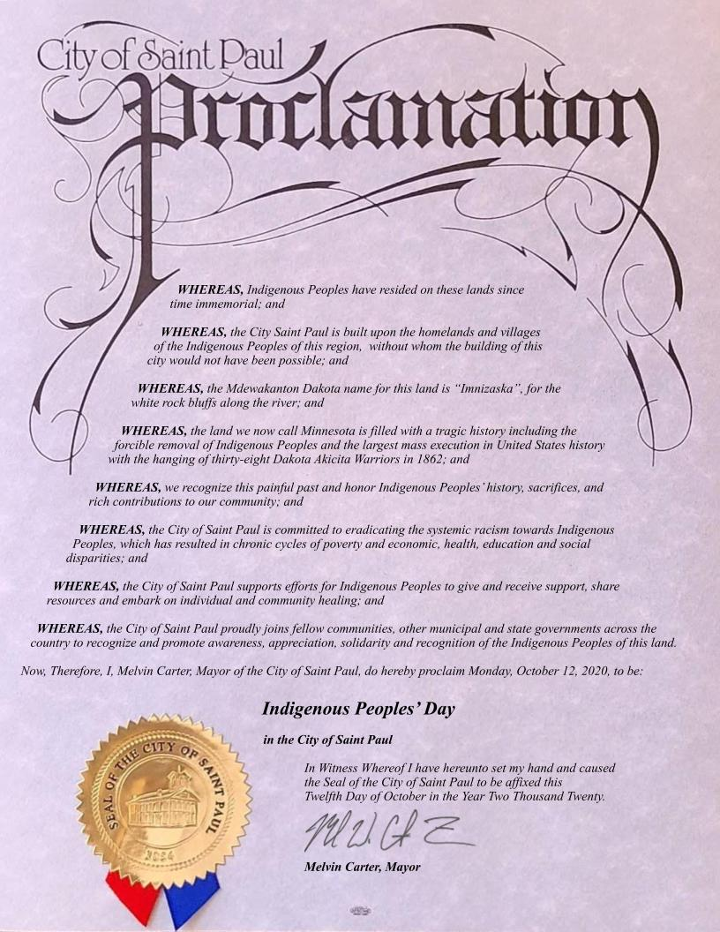
Mayoral Proclamations
Mayoral proclamations are important tools that help you gain recognition in your local community
Proclamations are used to recognize significant events or accomplishments, raise awareness around important issues, and highlight milestones
Proclamations are often noted in local media outlets and shared online
Organizations can often get framed copies of proclamations

Slide 7
Media Relations
Placing stories in local media outlets can help increase awareness of disability services, demonstrate the important impact of day and employment services, and sway public opinion
Legislators often pay more attention to stories in their local media outlets than they do to statewide outlets
There are endless opportunities to highlight the importance of day and employment services throughout the state

Slide 8
Media Relations
How do you get the media to tell your story?
Know your local outlets and reporters
Cultivate relationships
Demonstrate your expertise
Use your connections – MOHR can support you
How to share information?
News releases
Media advisories
Pitches

Slide 9
Elements of a Good Story
It impacts a large number of people, or a small group in a significant way
It is of interest to your community
It is timely
An influential figure is attached
It tugs at the heart strings
It is unique and different
Its highly visual

Slide 10
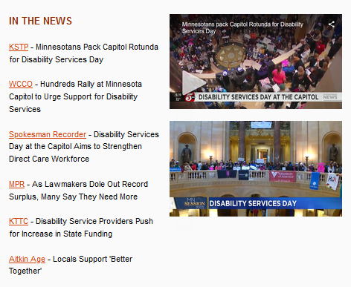

Slide 11
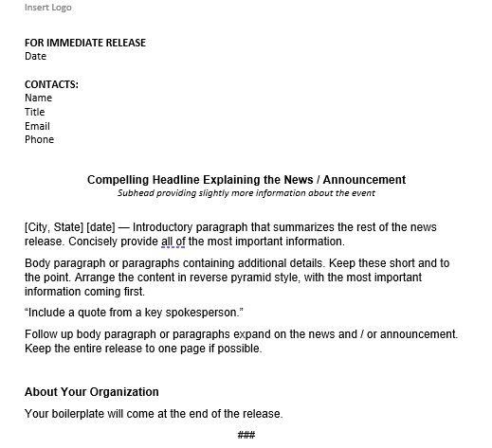

Slide 12
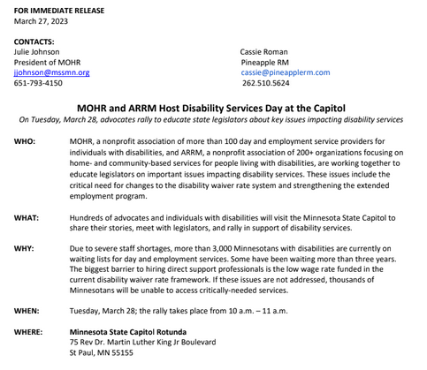

Slide 13
Disability Services Day at the Capitol - Tuesday, March 28
As part of MOHR and ARRM's Disability Services Day at the Capitol, hundreds of advocates and individuals with disabilities will visit the Minnesota State Capitol to share their stories, meet with legislators, and rally in support of disability services on Tuesday, March 28 at 10 a.m. The goal is to educate legislators on important issues impacting disability services. These issues include the critical need for changes to the disability waiver rate system and strengthening the extended employment program.
Due to severe staff shortages, more than 3,000 Minnesotans with disabilities are currently on waiting lists for day and employment services. Some have been waiting more than three years. The biggest barrier to hiring direct support professionals is the low wage rate funded in the current disability waiver rate framework. But, since staff pay rates are largely controlled by legislative action, only legislative action can solve the problem. If these issues are not addressed, thousands of Minnesotans will be unable to access critically-needed services.
I'd be happy to arrange for you to speak with leaders from MOHR and ARRM as well as individuals with disabilities who are impacted by these legislative issues. Please let me know if you'd like to arrange an interview.
Best,
Cassie Roman

Slide 14
Letter to the Editor and Op-eds
Many publications allow individuals to write letters to the editor or submit an op-ed
These authored articles are a powerful tool to tell your story since they are published in your own words
A good letter to the editor or op-ed is timely and addresses an important issue impacting your community
An impactful letter gets to the point quickly and ends with a call to action
Letters to the editor are short (200 – 300 words); Op-eds can be a big longer (700 – 800 words)
Every outlet has its own rules for submitting a letter or op-ed

Slide 15
Community Engagement
Maintaining a regular presence in your community will increase goodwill and understanding
Look for opportunities to participate in community celebrations (parades, music in the park, National Night Out, etc.)
Find ways to partner with community organizations for volunteer opportunities
Look for speaking opportunities with local groups (Rotary Clubs, scouting troops, school groups, etc.)
Host open houses whenever possible

Slide 16
Social Media
Develop a communications plan for social media
Participate in larger conversations and build a community that supports your work
Leverage your community including MOHR, local organizations, other members, etc.
Utilize photos and short videos whenever possible
Empower staff, participants, families, etc. to share their stories
Develop your voice – you can choose to be funny, informative, etc.
Utilize free tools and software including Canva and Animoto
Use MOHR for support (@mohrmn1)

Slide 17
Impact Report
Impact reports demonstrate the value of your organization and your effect on the community
These are often used as fundraising pieces
Many organizations use these to highlight their most important work from the previous year
Statistics and visuals are important ways to make these pop
Many organizations are publishing digital impact reports rather than printing them
Impact reports are important to share with legislators, major donors, grant organizations, as part of award nominations, etc.

Slide 20
Questions?

