Slide 1

State and Federal Trends in 2025
David Dively | Executive Director

Slide 2
Items we will cover today
Introduction
About the Minnesota Council on Disability
Policy trends
Rights and protections
Budgets
What next?

Slide 3
MCD’s Policy Team
David Dively, Executive Director
Joel Runnels, Ph.D., Legislative Affairs Director (legislative and policy)
Linda Wolford, Government Affairs (cross-government)

Slide 4
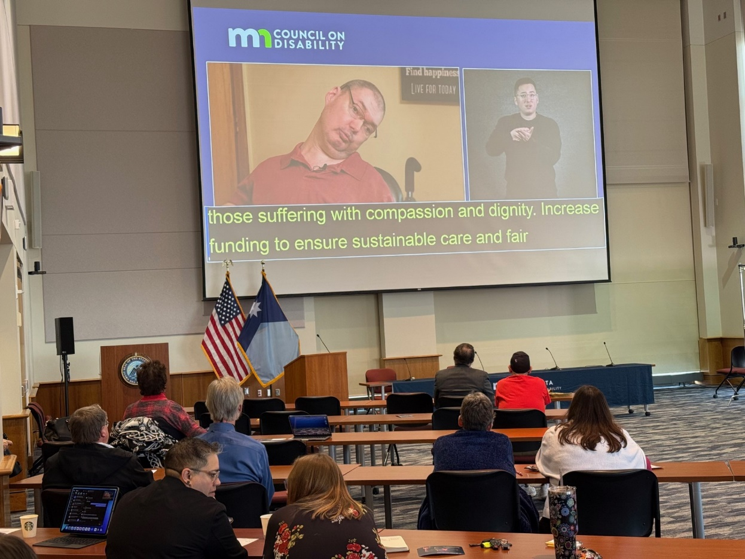
Who and what is the Minnesota Council on Disability?
17 Governor-Appointed Council Members
Approx. 12 FTE
An independent state agency
Policy, Training, and Technical Resources

Slide 5
Use our online bill tracker and legislative updates
Nearly 7,000 bills this year
Bill Tracker (https://www.disability.state.mn.us/about-our-public-policy/bill-tracker/)
HF 1671 & SF 2149 – Chief Authors: Representative Pinto & Senator McEwen – ACTIVE
Governor’s Labor Bill which includes elimination of subminimum wage

Slide 6
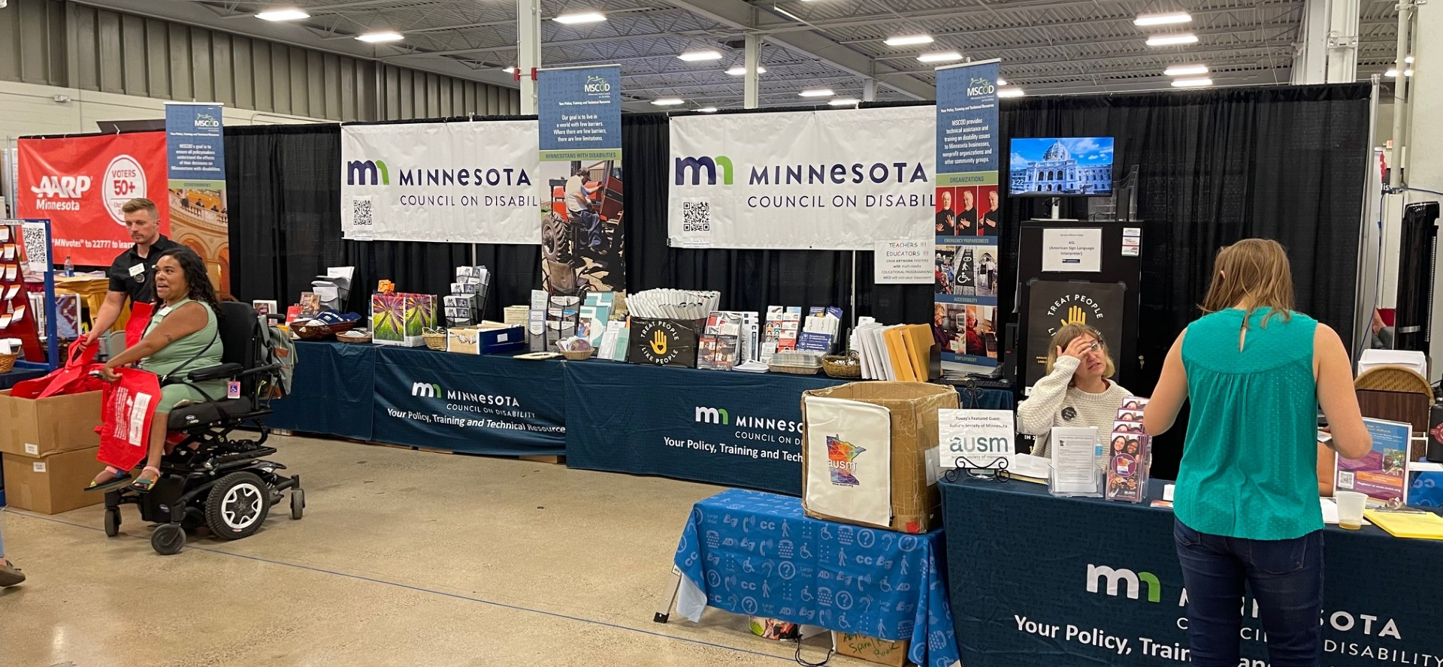
State Fair, Education Building

Slide 7
We will discuss words, concepts, and pictures about disability and ableism that may be offensive. They are part of our history, so we can’t ignore them.
Please support yourself and take breaks as needed.

Slide 8
Statistics
Approximately 24% of the US population has a disability as defined by law*.
Largest voting bloc and demographic in Minnesota
52% of the population 65 years of age and older has a disability.
Globally the disability community has exceeded the population of China at 1.3 billion people.
More likely to be part of Communities of Color and the LGBT community

Slide 9

History Repeating
Insidious Ideas:
In 2024 and 2025, the rise (again) of eugenics, vaccines, and the false connection to Autism.
Reconsidering of past victories:
Restraints in schools
Seclusion rooms in schools
504 Rulemaking
The right to vote with a disability
US Dept of Energy proposing rules to get around Architectural Barriers Act.

Slide 10
State Trends
DHS completes re-organization into three separate agencies:
  Children, Youth, and Family
  Direct Care and Treatment
  Department of Human Services
Reduced backfilling of positions
Little or no new spending for two+ bienniums
Increased state and local share

Slide 11
Additional Considerations
Continued housing shortages
Order of Selection for Vocational Rehabilitation
Grant management for fraud, waste, and abuse.
Reduced federal grands and funding creating downward pressure. Many state grants in disability are tied to federal programs like the DD Act.

Slide 12
Federal Trends
Continuation of the 14c Subminimum Wage program
Reduced regulations for physical and digital access for federal and local government
USDOJ is not prioritizing disability protection enforcements
Increased need for employment supports as economy tightens.

Slide 13
Three Historical Divides for Consideration
Parents vs. children
Providers vs. disabled clients
Disabled vs. non-disabled
Controversies and disagreements within the disability community cause a significant amount of the public policy problems we have today.
In today’s climate, we need to figure out how to minimize these divides and work on collaboration.

Slide 14
Thank You!
David Dively
David.Dively@state.mn.us
mn.gov/mcd
Joel Runnels, Ph.D.
Joel.Runnels@state.mn.us
mn.gov/mcd

