Slide 1
MN Employment Law Changes:
What’s Coming in 2026, and Implications for MOHR Members
Janet Dorr
Shareholder
Fredrikson & Byron

Slide 2

Overview
Meal & Rest Breaks
Earned Sick and Safe Time
Paid Family and Medical Leave
Questions

Slide 3
Meal & Rest Breaks

Slide 4
New Specific Minimum Requirements
Every 4 consecutive hours
  15-minute paid break or enough time to use nearest restroom (whichever is longer)
Shift of 6+ consecutive hours
  30-minute unpaid meal break
Action Items:
Revise handbooks/policies that conflict
Communicate to managers and EEs

Slide 5
Earned Sick and Safe Time

Slide 6
Slight Modifications (phew!)
Documentation
  Can request after ESST used for 2 consecutively scheduled workdays
  (was 3)
Notice for Unforeseeable Absences
  Can require notice “as reasonably required” (was “as soon as practicable”)
  Allows ERs more discretion in setting expectations
Advancing Hours
  Can advance hours based on anticipated hours for the year, but must make up the difference if EE works more and earns more ESST

Slide 7
Paid Family and Medical Leave Law
(“PLL”)

Slide 8
PLL Quick Overview

Slide 9
PLL Fundamentals
Protected leave which provides partially-paid time off for medical, family, and safety-related reasons
Administered by DEED
  Starting premium is 0.88% of EE’s taxable wages up to cap
  Up to half of the premium can be charged to EE via payroll deduction
Based on a single qualifying event of at least 7 calendar days
  Must be consecutive unless leave is intermittent
  Does not apply to bonding

Slide 10
Types of Leave
20 Weeks Combined Maximum
12 Weeks Medical Leave
12 Weeks Family Leave
Medical Leave
EE’s serious health condition
Caring Leave
Family member with a serious health condition
Bonding
Safety Leave
Domestic abuse, sexual assault, stalking
Medical attention, support, legal advice, relocation, counseling, etc.
Qualifying Exigency Leave
Active-duty service or impending call
Childcare, arrangements, counseling, military events, etc.
Medical care related to pregnancy

Slide 11
Small Employer Premiums
“Small Employers” include:
  30 or fewer EEs
  and
  Average EE wage is less than 150% of state’s average wage
Qualifying small employers pay reduced premium
  Premium is 75% of standard premium rate
  ER must cover at least 25% (0.22%); can shift remainder to EE

Slide 12
“Benefit Year”
State plan: 52 weeks beginning the effective date of leave
  Consider aligning FMLA year
Private plan: Flexible options for determining benefit year
  Calendar year, or
  Any fixed 12-month period (e.g., anniversary year), or
  A rolling 12-month period measured forward, or
  A rolling 12-month period measured backward from first date of leave

Slide 13
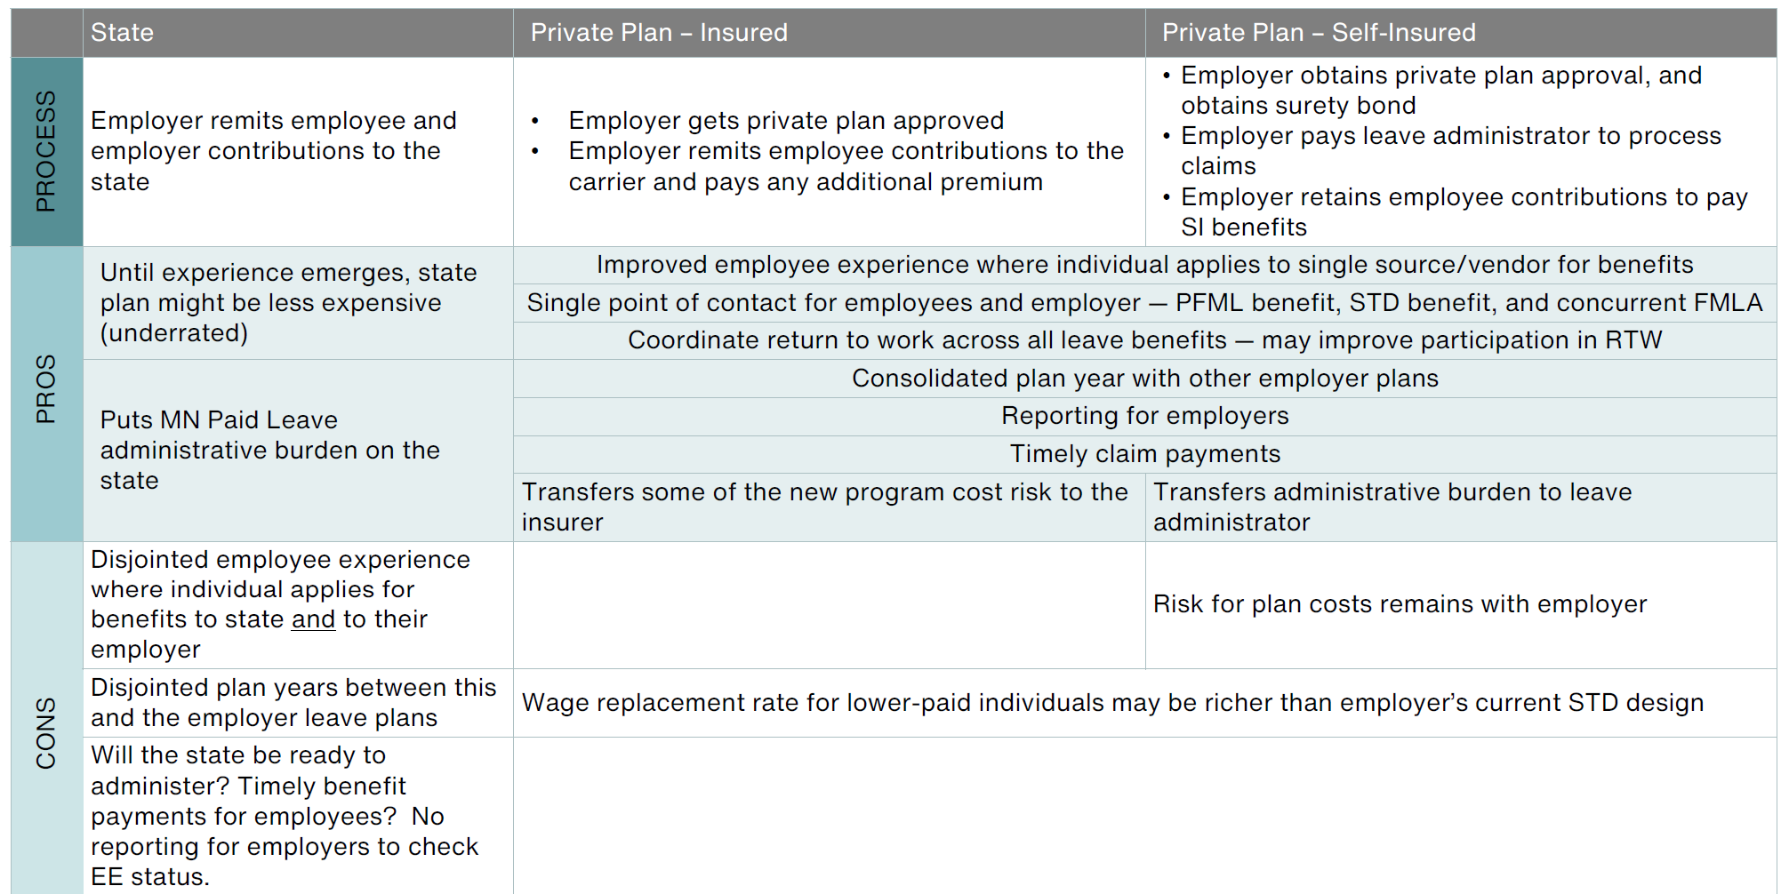
“Selling Points” of Private Plans

Slide 14
PLL Fundamentals: Summary
Medical, safety, caring, and exigency leave
7-day qualifying event, with notice and certification
12-week max for medical, 12-week max for family, 20-week max if both
0.88% premium on wages (up to cap); can be split between ER and EE
Small ERs enjoy lower premium rate

Slide 15
PLL Action Items
Now
Decide whether you will go with the state plan or a private plan
Next 2 Months
Review leave policies to determine if they need revision
Adjust FMLA benefit year if necessary
Decide whether to require EEs to contribute toward premium
  If so, confirm minimum wage met and whether to adjust salaries

Slide 16
Action Items
By End of Year
Ensure approval of private plan if applicable
Post notice at worksites and distribute written notices to EEs (due 12/1; DEED will provide examples)
Issue revised policies/handbooks
Plan for leaves starting January 1, including bonding leaves from 2025
2026
Begin deducting premiums from EE paychecks starting January 1

Slide 17
Interaction with Other Types of Leave
Family and Medical Leave Act (“FMLA”)
Pregnancy and Parental Leave (“MPPL”)
Earned Sick and Safe Time (“ESST”)

Slide 18
PLL and FMLA

Slide 19
Key Differences between PLL and FMLA
 | PLL | FMLA
Paid or Unpaid? | Paid by state at % of pay up to cap | Unpaid
Amount of Leave | Up to 20 weeks | Up to 12 weeks (26 for military caregiver)
Covered Employers | Nearly all MN employers | 50+ employees in 20 or more workweeks
Covered Employees | Earned at least 5.3% of statewide average wage in last year | Employed 12 months, at least 1,250+ hours in past 12 months, at location with 50+ employees within 75 miles
When Triggered | 7-day qualifying absence | Qualifying absence
Qualifying Absences | --Can be used for more types of absences, includes safety leave --Broader definition of “Family Member” | --Narrower uses --Narrower definition of “Family Member”
Leave Year | Starts when leave starts (under state plan) | Employer can designate

Slide 20
PLL Covers More Family Members than FMLA
PLL adds the italicized family members:
  Spouse or domestic partner
  Child
    Including biological, adopted, foster, stepchild, child of a domestic partner, and children whom the applicant is in loco parentis, legal guardian of, or de facto custodian
  Parent and spouse’s parent
  Sibling
  Grandchild
  Grandparent or spouse’s grandparent
  Individual with personal relationship creating expectation and reliance of care without compensation

Slide 21
PLL and FMLA Example 1
Emily takes 12 weeks of FMLA leave for a serious health condition but decides not to apply for PLL even though it would apply.
In the same leave year, Emily applies for 12 weeks of PLL for a separate medical condition. Is she entitled to PLL leave?
Probably. Emily cannot be compelled to take PLL for the first leave. The statutes and rules suggest than an EE may only be compelled to take FMLA during PLL if the leaves are for the same purpose.

Slide 22
PLL and FMLA Example 2
Emily had a child in April 2025 and took 12 weeks of leave under the FMLA and her company’s leave policy.
On January 1, 2026, she applies for 12 weeks of PLL bonding leave for the same child.
Is Emily entitled to PLL even though she took FMLA leave for the same reason within the past 12 months?
Yes. DEED has advised that 2025 leaves do not impact PLL entitlements.

Slide 23
PLL and the Pregnancy and Parenting Leave Act

Slide 24
Key Differences between PLL and MPPL
 | PLL for Pregnancy/Bonding | MPPL
Paid or Unpaid? | Paid by state at % of pay up to cap | Unpaid
Length of Leave | Up to 20 weeks | Up to 12 weeks (plus prenatal care appointments)
Covered Employees | Earned at least 5.3% of statewide average wage in last year | Day 1 of employment
When Triggered | Eligibility ends 12 months after birth/adoption | Must begin within 12 months of birth/adoption
Qualifying Absences | --7-day qualifying absence --Bonding | --Prenatal care --Incapacity due to pregnancy, childbirth, or related conditions --Bonding

Slide 25
PLL and MPPL Example
After returning from a 12-week PLL personal medical leave, John has a child. John requests additional leave for bonding.
Is John entitled to additional bonding leave, if so, how much?
Yes. John is entitled to:
8 weeks under PLL (maxing out the 20 week cap)
Plus 12 unpaid weeks under MPPL

Slide 26
PLL and Earned Sick and Safe Time

Slide 27
Key Differences between PLL and ESST
 | PLL | ESST
Paid or Unpaid? | Paid by state at % of pay up to cap | Paid by employer at 100% of base rate
Amount of Leave | Up to 20 weeks | 1 hours per 30 hours worked, up to 48 hours year; or 48/80 frontloaded
Covered Employees | Earned at least 5.3% of statewide average wage in last year | Expected to work 80 hours/year in MN
When Triggered | 7-day qualifying absence | Any qualifying absence of any length; can be used in 15 min. increments
Qualifying Absences | --Different uses, including exigency and bonding --Different definition of “Family Member” | --Different uses including preventative care, bereavement, closings, and communicable diseases --Different definition of “Family Member”
Documentation | Health care provider or designated professional must certify need | Limits on requesting documentation
Leave Year | Starts when leave starts (under state plan) | Employer can designate

Slide 28
PLL Covers Less Family Members than ESST
PLL & ESST | ESST ALSO ADDS
Spouse/Partner Child (biological, adopted, step, foster, or a child employee raises) Parent or person who raised employee Sibling Grandchild Grandparent In-laws (son, daughter, father, mother) Anyone close to employee who depends on them like family, even if not related by blood | Stepsibling, foster sibling, sibling-in-law Foster grandchild or step-grandchild Step-grandparent Nephew/Niece Aunt/Uncle Any “Family Member” of the spouse/partner Up to one individual annually designated by the employee

Slide 29
ESST and PLL Example 1
Sarah had surgery and took 12 weeks of PLL for recovery. Sarah is now requesting time off to care for her sister who has cancer.
  Is Sarah entitled to additional leave?
  Can Sarah’s employer require that she use her ESST, rather than her remaining PLL?
Sarah is entitled to:
Up to 8 weeks of “Caring” leave (to get to 20 week max)
Save her PLL and only use ESST

Slide 30
ESST and PLL Example 2
In the middle of the day, Sam learns his daughter is sick at school, and he uses ESST to go pick her up
Over the weekend, Sam learns from his daughter’s physician that this is a longer-term illness, and he will need to be home for two weeks to care for her.
Can Sam refuse to apply for PLL and refuse to use ESST?
Yes. Cannot force EEs to use PLL or ESST – but can discipline for unexcused absences.

Slide 31
Leave Policy Action Items
Evaluate current leave policies
  Unlimited PTO plans can handcuff ERs
  Decide whether to separate PTO and ESST “buckets”
Find ways to incentivize EEs to stack their leaves
  Offer to “top up” PLL benefits only in certain circumstances
    Example: Parental leaves are unpaid unless employee takes PLL. If EE takes PLL, company will “top up” pay so EE receives 100% of salary
  Only allow PTO to be used in certain circumstances

Slide 32
Questions?

