Slide 1


DHS Update – MOHR Legislative Conference
September 4, 2024
Heidi Hamilton| Disability Services Division Director

Slide 2
Agenda
Waiver Reimagine
Federal Legislation

Slide 3

Waiver Reimagine

Slide 4

Waiver Reimagine: What is it?
Waiver Reimagine is the name of ongoing work that will:
  Reshape the disability waiver program structure
  Expand informed choice and informed decision making for Minnesotans accessing services
  Transition to an individual budgeting model for people who access disability waivers.
These changes will link a person’s needs to the amount spent in their service plan.
Services & supports will align to a person’s needs – not their diagnoses.

Slide 5
Goals of Waiver Reimagine
Better Access and Flexibility
Simplify information about services and the process to apply for services
Equitable Access
Each person can access services and funding equitably, regardless of their county or tribal nation
Self-Direction
Increase self-direction options
Provide complete, accurate, and accessible information, so a person can make informed choices while planning services.
Eliminate discrepancies based on disability type or diagnosis
Provide information to help a person make decisions

Slide 6
History

Slide 7




Waiver Reimagine Phases
Phase One - complete
Phase Two – in progress
Common
service menu across all waivers
Two waiver system based on where a person lives and not on their diagnosis
A known and transparent budget based on a person’s needs
Informed decision making and increase flexibility
to self-direct
Notes:
In 2019, the Minnesota Legislature authorized the Department of Human Services (DHS) to make system-level improvements to Minnesota’s disability waiver programs, starting with simplifying the waiver service menu (bringing like services together) available across the four waivers. We call this waiver reimagine Phase One The simplified/common service menu launched in January 2021 and was implemented during reassessments throughout 2021. This phase is complete. Various stakeholders were involved in the development of the common service menu and throughout 2021, we have been and will continue to provide technical assistance and support to people, families, lead agencies and providers through the transition.
During the 2021 1st Special Session, the Minnesota Legislature authorized DHS to implement the next phase of the Waiver Reimagine project. We are calling this “phase 2”. Phase 2 includes:
Reshaping the four current disability waiver programs into a two-waiver structure
Transitioning to individualized budgets for people who use disability waivers
Increasing access to and options for self-directed services
Developing a web-based online support-planning tool for people with disabilities and families. The tool will provide information about their assessment, support plan, services, budgets and resources to help them plan for services.
(As needed) Timeline of changes
2017-18:
DHS conducted extensive research and stakeholder engagement that informed what would become Waiver Reimagine.
2019:
Simplifying the service menu changes were passed into law.​
2020:
Conducted research on reshaping the waivers, support ranges (individual budgets) and self-direction.
DHS conducted more stakeholder engagement events to inform policy and a second legislative report. ​
2021:
Simplifying the service menu changes took effect Jan. 2021.
Waiver reimagine Phase 2 passed into law which includes transition to individual budgets and a 2-waiver system
2022 and beyond:
Develop waiver amendment language and receive feedback from interested parties
Partner engagement
Submit waiver amendments to the federal government, develop policies and procedural guidance
Begin rolling implementation of individual budgets and 2-waiver system.

Slide 8
Waiver Reimagine: Waiver Structure
Waiver 1: For people living in their own home/family home
Brain Injury (BI) Waiver
Community Alternative Care (CAC) Waiver
Community Access for Disability Inclusion (CADI) Waiver
Waiver 2: For people living in provider-managed residential homes
Developmental Disabilities (DD) Waiver
Notes:
Through multiple years of research to identify efficiencies, simplifications, and improvements, we will be reshaping the four disability waivers - BI, CAC, CADI, and DD – into a two waiver structure. The new two-waiver system simplifies the waiver programs by aligning waivers based on where people choose to live, rather than their diagnosis. Right now, a person’s diagnosis or required level of care determines their eligibility for one of the four current disability waivers.
Both of the new waivers---will encompass the current four levels of care and other eligibility criteria associated with the four current waivers. As a result, eligibility requirements will remain essentially unchanged for people who use services. This is intended to create unity between the two waivers, increase equity and make them easier to understand and navigate.

Slide 9
Waiver Reimagine: Individual Budgets
Individual budget methodology
Each person is assigned to a support range budget based on the results of their MnCHOICES assessment.
The person chooses which services and supports to access within their budget.
Current budget methodology
There is not one specific way to determine how much a person can spend on traditional waiver services.​
Instead, each lead agency balances people's waiver spending together within a single budget.​
Notes:
with a verbal recognition of the equity impacts as a transition into the next slide

Slide 10
How will people and families be impacted?
What will change..
Individualized Budgets
Increase in informed choice training/information
What will stay the same...
People will still need to meet current level of care eligibility requirements.
DHS is not adding new services to the waiver programs as we transition from four waivers to two.
Consistency and transparency in allocation of funds across the state
Notes:
Increase in informed choice training/information
DHS will enhance training for lead agencies to ensure people accessing supports are offered informed choice and informed decision making.
DHS will revise case management qualification to support equity in the service experience people receive

Slide 11
Waiver Reimagine: Providers
Waiver Reimagine impacts providers by…
  Standardizing practices
  Applying policies consistently and equitably
  Simplifying processes and creating clear information has a positive impact on providers
Providers will continue to deliver person-centered services as identified in the person's Support Plan, service agreement and according to requirements.
Notes:
Getting feedback through public engagement to understand the needs people have for diverse providers
Hearing from public about what their needs are for providers
Support provider to
Working with providers to uphold their choice within waiver services
When we simplify process and create clear information this has a positive impact on providers
Applying policies Consistently to support our provider
WR will help us understand what people will need

Slide 12
Next Steps for Waiver Reimagine Implementation
DHS identified Waiver Reimagine as one of top priorities
  MNIT resources
  DHS-wide resources
Waiver Reimagine Task Force begins meeting November 2025
Person Portal available July 2026
Launch Waiver Reimagine January 2027, rolling launch based on assessment

Slide 13
Next Steps for Waiver Reimagine Implementation
Waiver Structure
  CMS technical assistance
  Public comment
  Formal submission to CMS
Individual Budgets
  Calculate budget ranges based on the revised MnCHOICES tool

Slide 14

Learn more about Waiver Reimagine
You can learn more by:
Visit the Waiver Reimagine website
Reviewing the frequently asked questions (FAQ) page
Subscribing to get DHS Disability Services Division eList announcements.
Emailing DHS at Waiver.Reimagine@state.mn.us with questions or input about Waiver Reimagine.

Slide 15
Comments? Questions? Considerations?

Slide 16


Federal Legislation – Preliminary Analysis

Slide 17
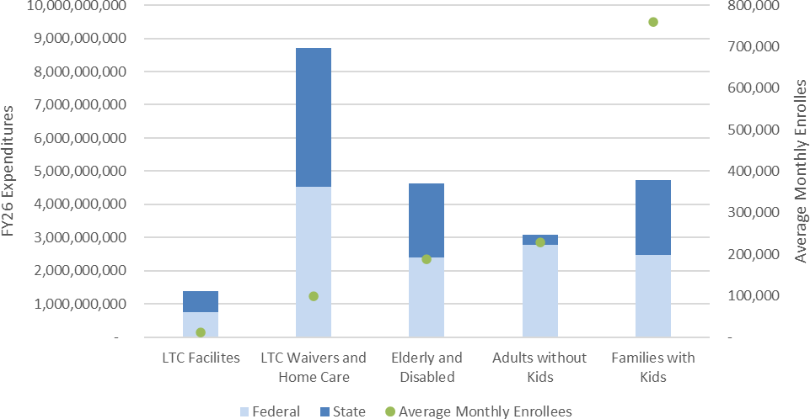
1.2 million average monthly enrollees
$23 billion total dollars
56% of spending funded by Federal Funds
Snapshot of Minnesota’s Medicaid Program (FY26 – EOS 2025 Forecast)

Slide 18
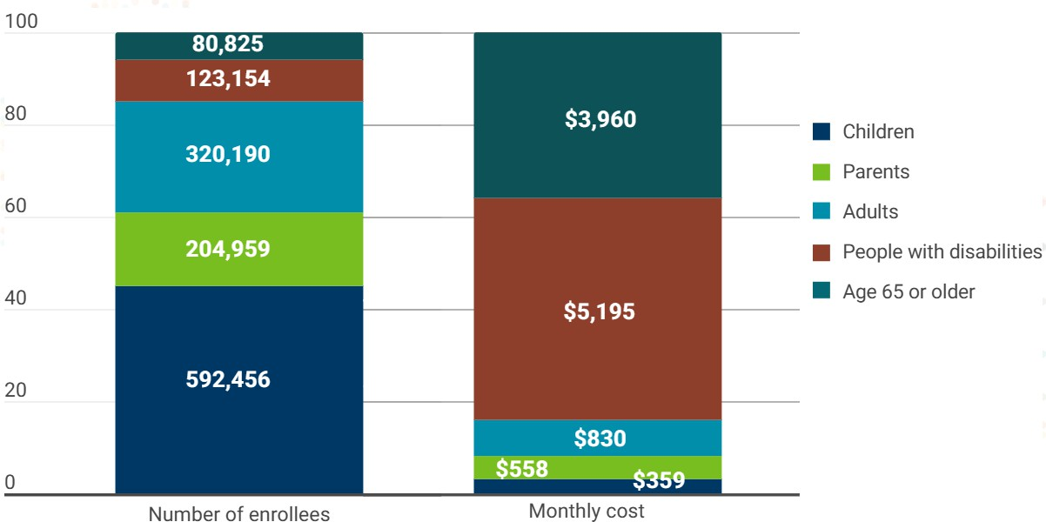
Population Served by Medicaid (FY24)

Slide 19
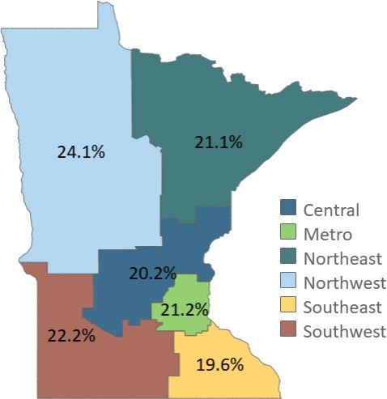
Population Served by Medicaid (FY24)

Slide 20
High Level Impacts
Estimates are preliminary (pending further analysis and CMS guidance)
Coverage losses will eventually exceed 140,000
Based on Congressional Budget Office (CBO) data and Minnesota-specific factors
Federal funding reductions will total roughly $1.1 billion in the first four years of enactment
Budget impacts are backloaded and grow over time
Impact to the state budget is still being analyzed
Counties will face hundreds of millions of dollars in new administrative costs
Impacts are cumulative and interactive

Slide 21
Section 71107: Six-Month Renewals
Currently annual renewals for Medicaid occur every 12 months. This provision requires states to verify Medicaid eligibility every six months for low-income adults
Effective date: Dec. 31, 2026 Impacted population:
Low-income adults in the expansion population
Does not apply to Tribal members and people living in U.S. territories
Fiscal impact:
State Administrative Costs: $4.9 million annually to complete additional data verifications against the federal hub
State Programmatic Costs (MA Forecast Impacts): Still being estimated
Costs to counties: Still being estimated

Slide 22
Section 71119: Work reporting requirements
This provision requires states to establish “community engagement requirements” for low-income adults without
children or disabilities ages 19-64 who are enrolled in the adult expansion group.
To meet community engagement requirements a person must be working, engaged in community or public service, actively seeking employment, or engaging in career planning or job training for 80 hours per month.
Community engagement requirements do not apply to:
Pregnant people
People under age 19 or over age 64
Foster care youth and former foster care youth under age 26
Members of American Indian Tribes
People who are considered medically frail
People who are already in compliance with the work reporting requirements under the Temporary
Assistance for Needy Families (TANF) program or Supplemental Nutrition Assistance Program (SNAP)
Parents or caregivers to a dependent child aged 13 or younger or a person with a disability
People who are incarcerated or released from incarceration within the past 90 days

Slide 23
Section 71119: Work reporting requirements (cont.)
Effective date: January 1, 2027. States may apply for a two-year extension request if they can show they are
making “good faith efforts” to implement.
Impacted people:
An estimated 20% of those enrollees subjected to the work requirements will have their coverage terminated
either through additional income, non-compliance, or administrative burden.
There will be an increase in physician visits as a portion of the caseload will seek a medically frail or mentally unfit exemption. Some adult enrollees will seek a disability determination if they don't see themselves as able to satisfy the work requirements.
This provision will increase the burden on county and Tribal workers trying to determine eligibility for Minnesotans.
Fiscal impact:
Potential of increase in local and tribal administrative costs of $160 million annually, an increase in state administrative costs of $5 million, a reduction in federal program funding of $200 million.
Additional programmatic fiscal impacts to Minnesota’s state budget are being estimated.

Slide 24
Section 71120: Cost sharing in MA expansion population
This provision requires states to impose cost sharing on Medicaid expansion adults with incomes over 100% percent of the federal poverty level. Currently, Minnesota does not have cost sharing in the MA program.
Requirements:
Cost sharing may not exceed 5% of the individual’s income or $35 per service
Cost sharing requirements exempt primary care, mental health, and substance use disorder services, as well as services provided by federally qualified health centers, behavioral health clinics, and rural health clinics
American Indians and Alaska Natives are exempt from cost-sharing requirements.
Effective date: October 1, 2028
Impacted people: Increased costs for adult expansion population. Many studies have found even very modest increases in cost-sharing lead to avoidance of care, which ultimately leads to more expensive care and more serious health risks. Additionally, where individuals are not able to pay their cost-sharing requirement this becomes uncompensated care for providers.
Fiscal impact: Increased out of pocket cost for Medical Assistance enrollees that total $4 million annually. State budget impact being estimated.

Slide 25
Questions?

Slide 26
Thank You!
Heidi Hamilton
Heidi.Hamilton@state.mn.us
651-431-2710

